Slide 1



Slide 2





© Child Evangelism Fellowship of Europe

Slide 3

© Child Evangelism Fellowship of Europe

Slide 4
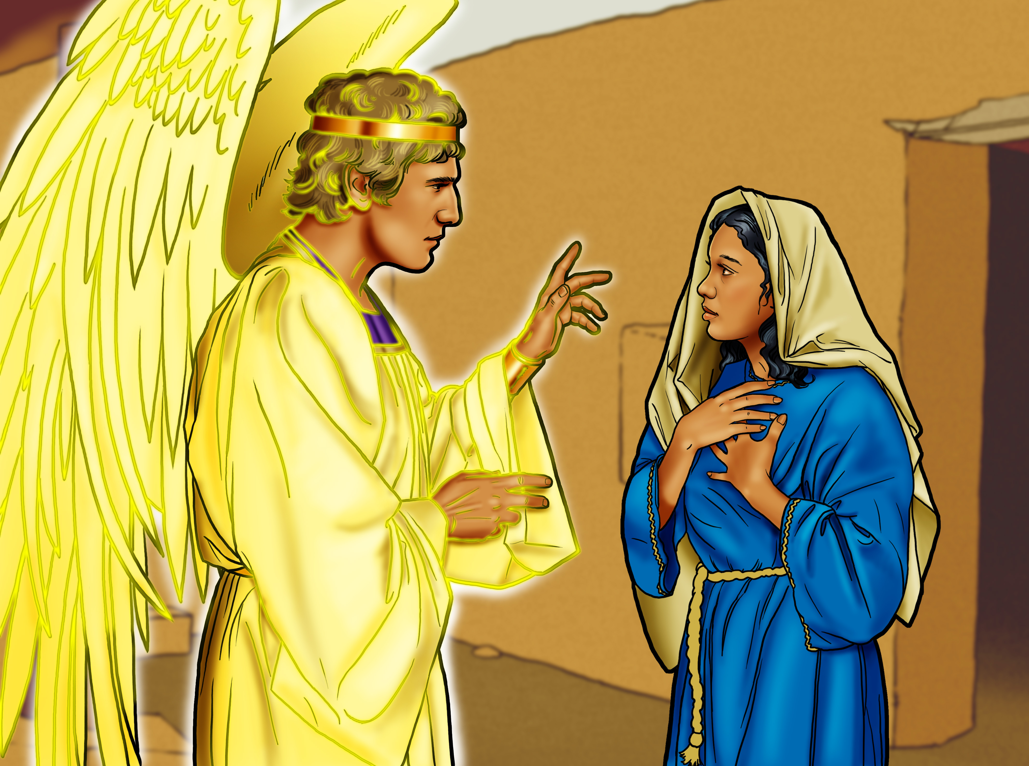
© Child Evangelism Fellowship of Europe, Child Evangelism Fellowship Inc.

Slide 5
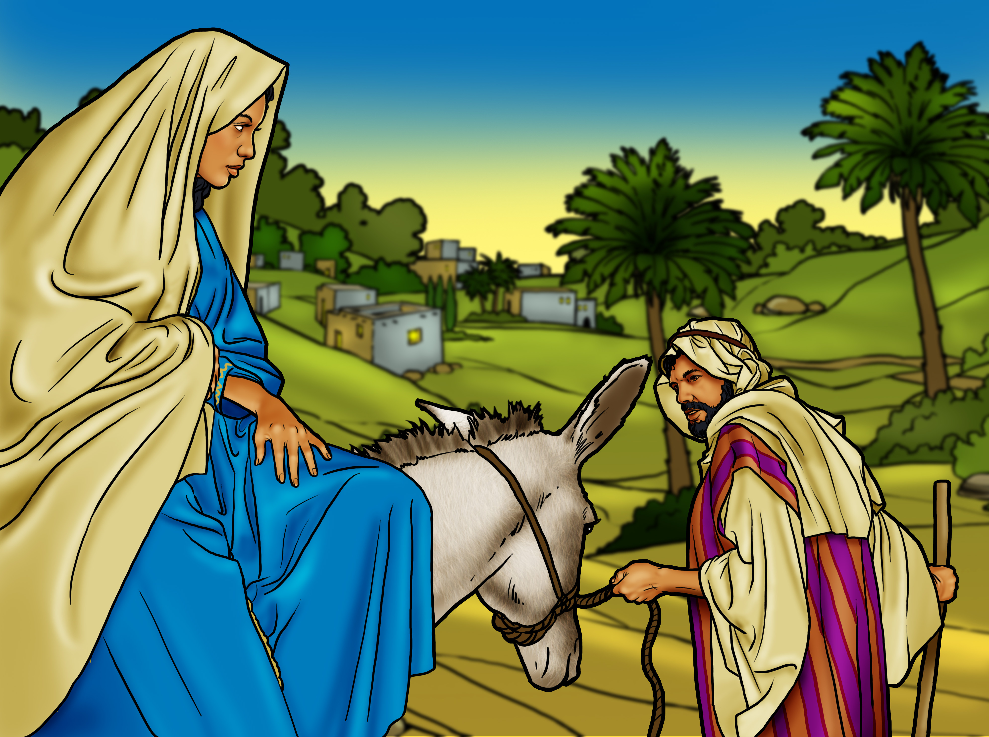
© Child Evangelism Fellowship of Europe, Child Evangelism Fellowship Inc.

Slide 6
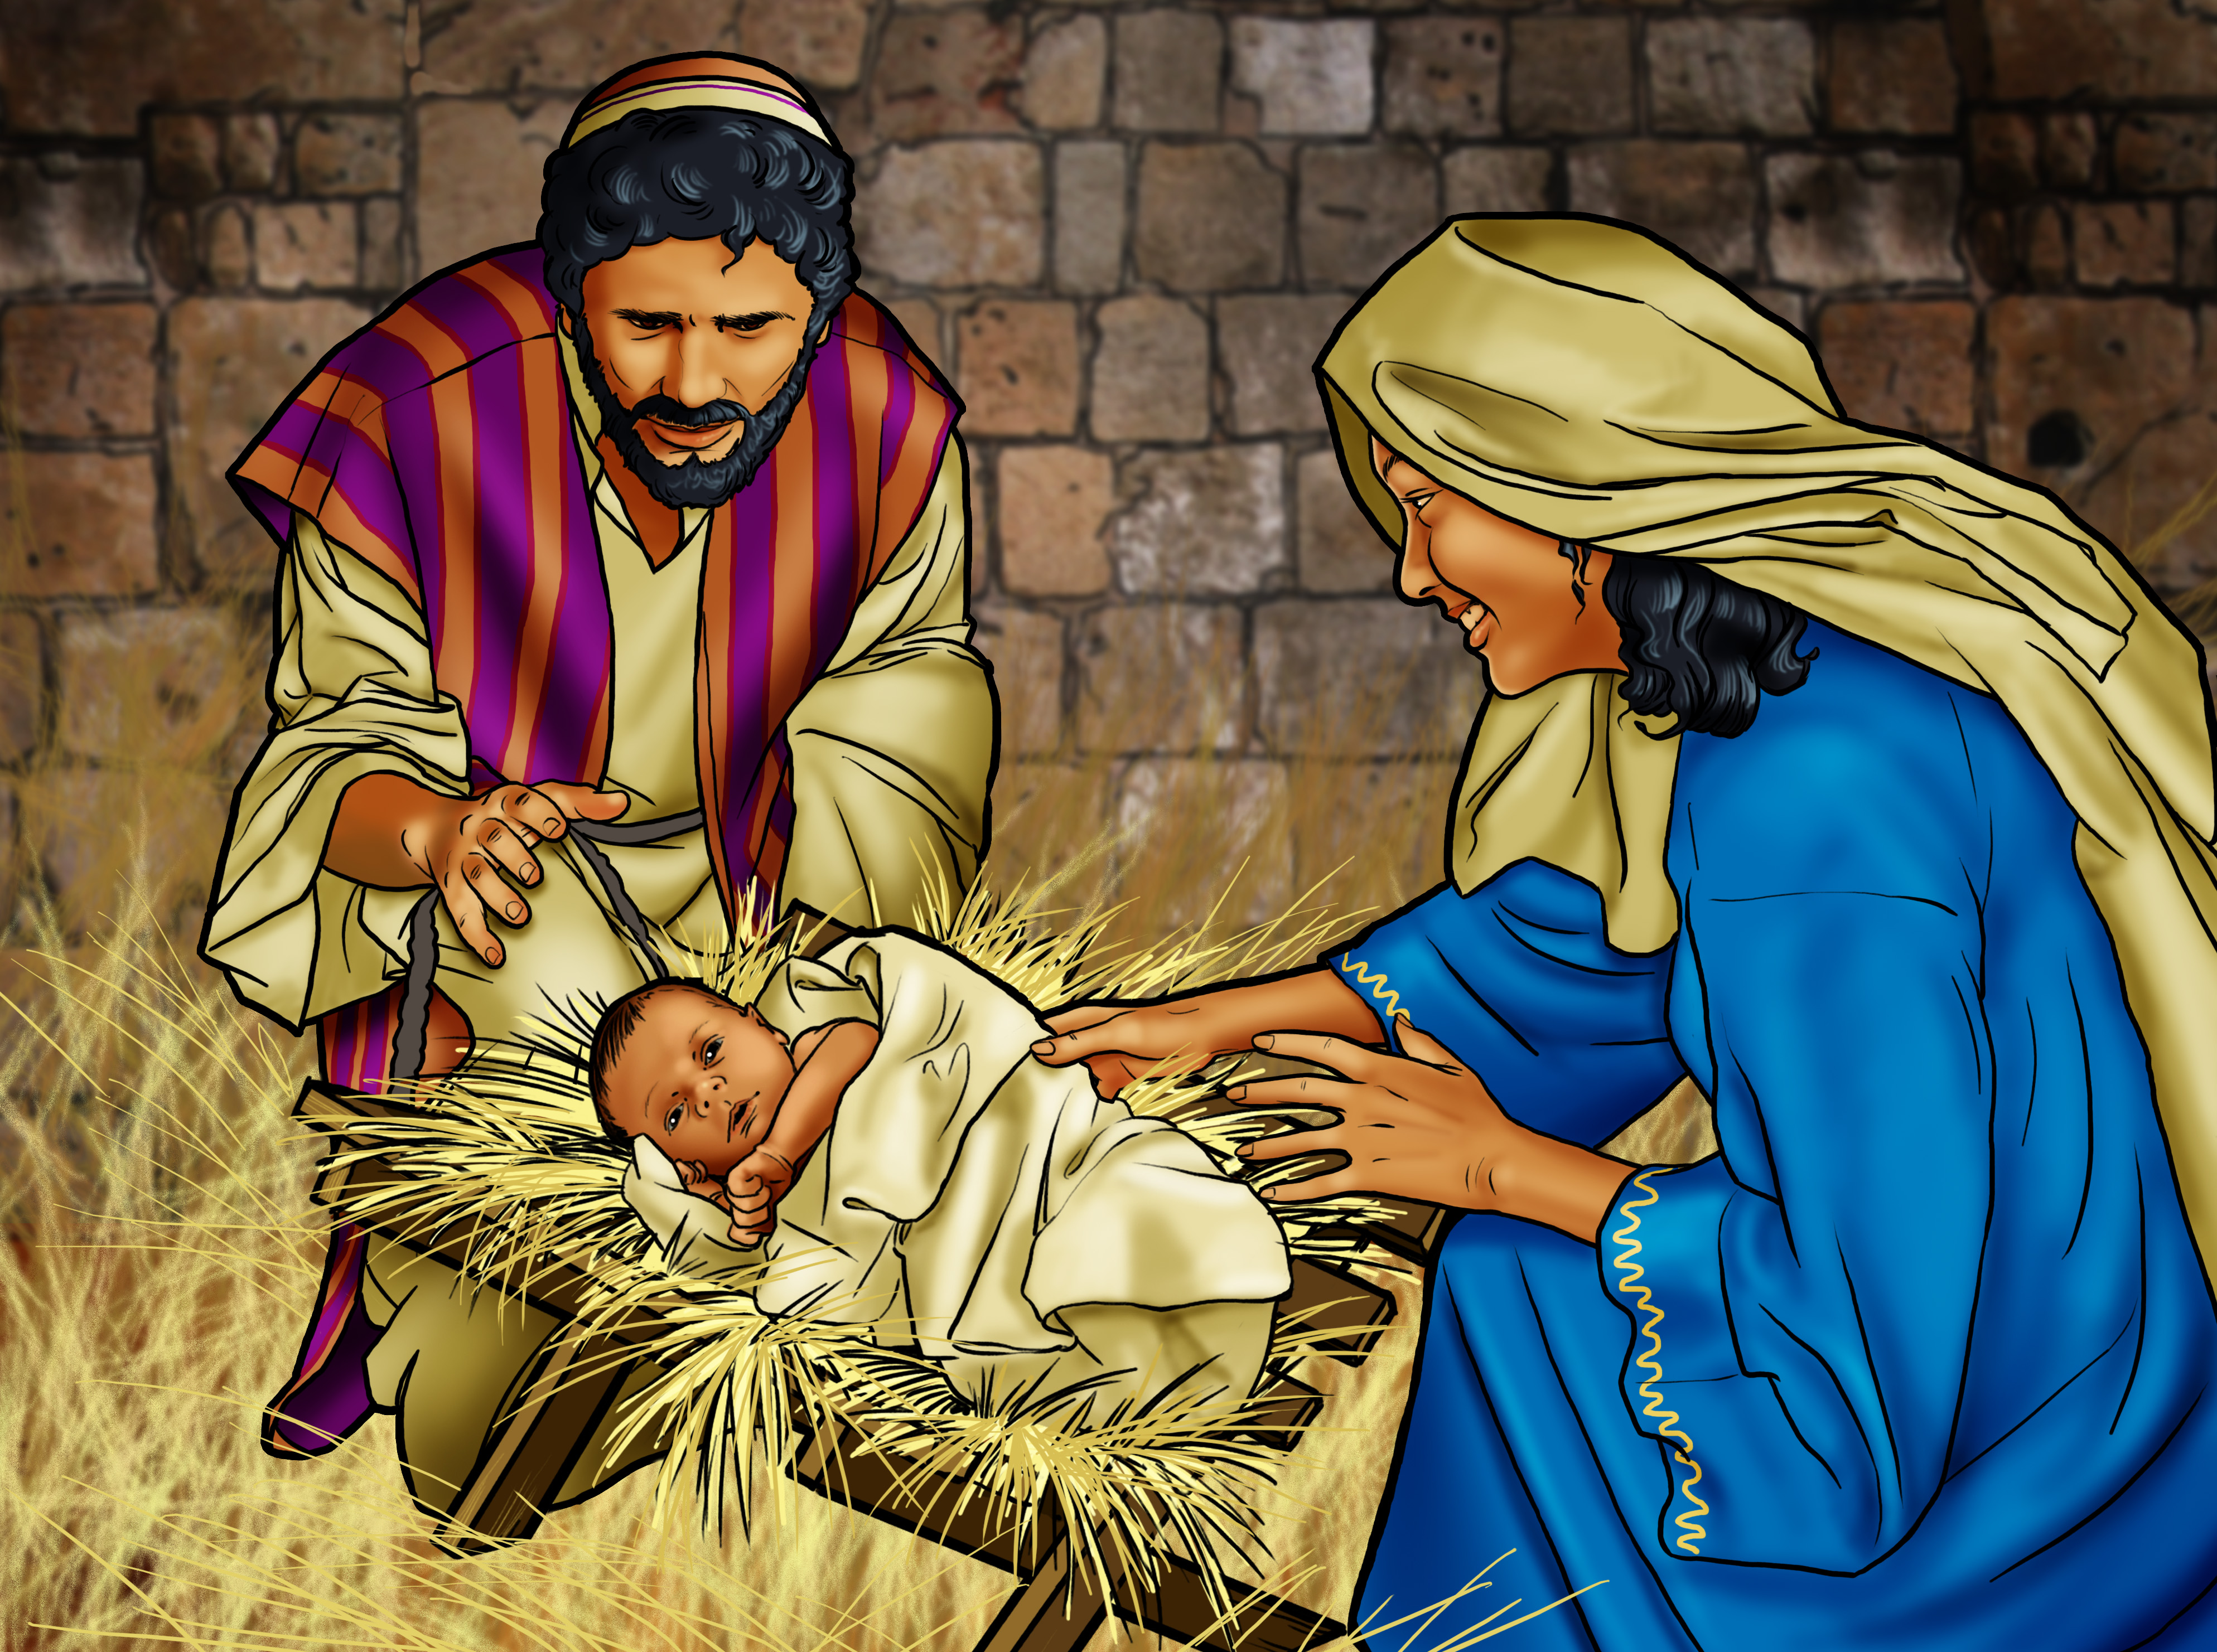
© Child Evangelism Fellowship of Europe, Child Evangelism Fellowship Inc.

Slide 7
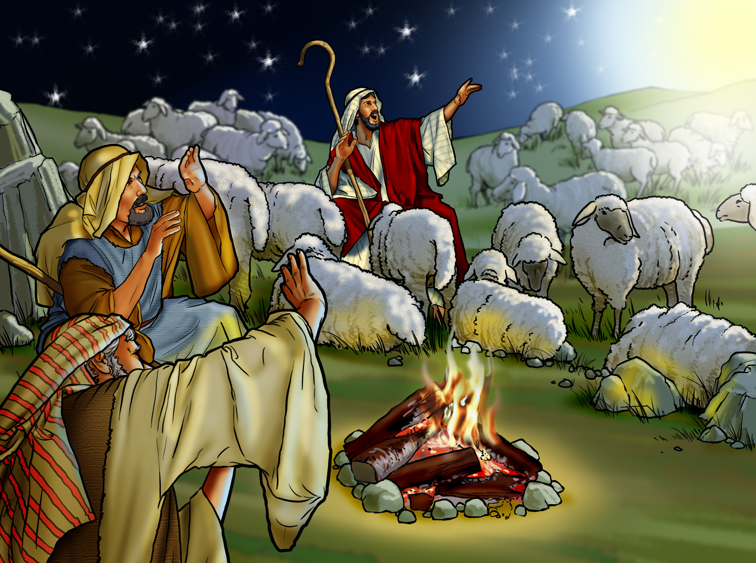
© Child Evangelism Fellowship of Europe, Child Evangelism Fellowship Inc.

Slide 8
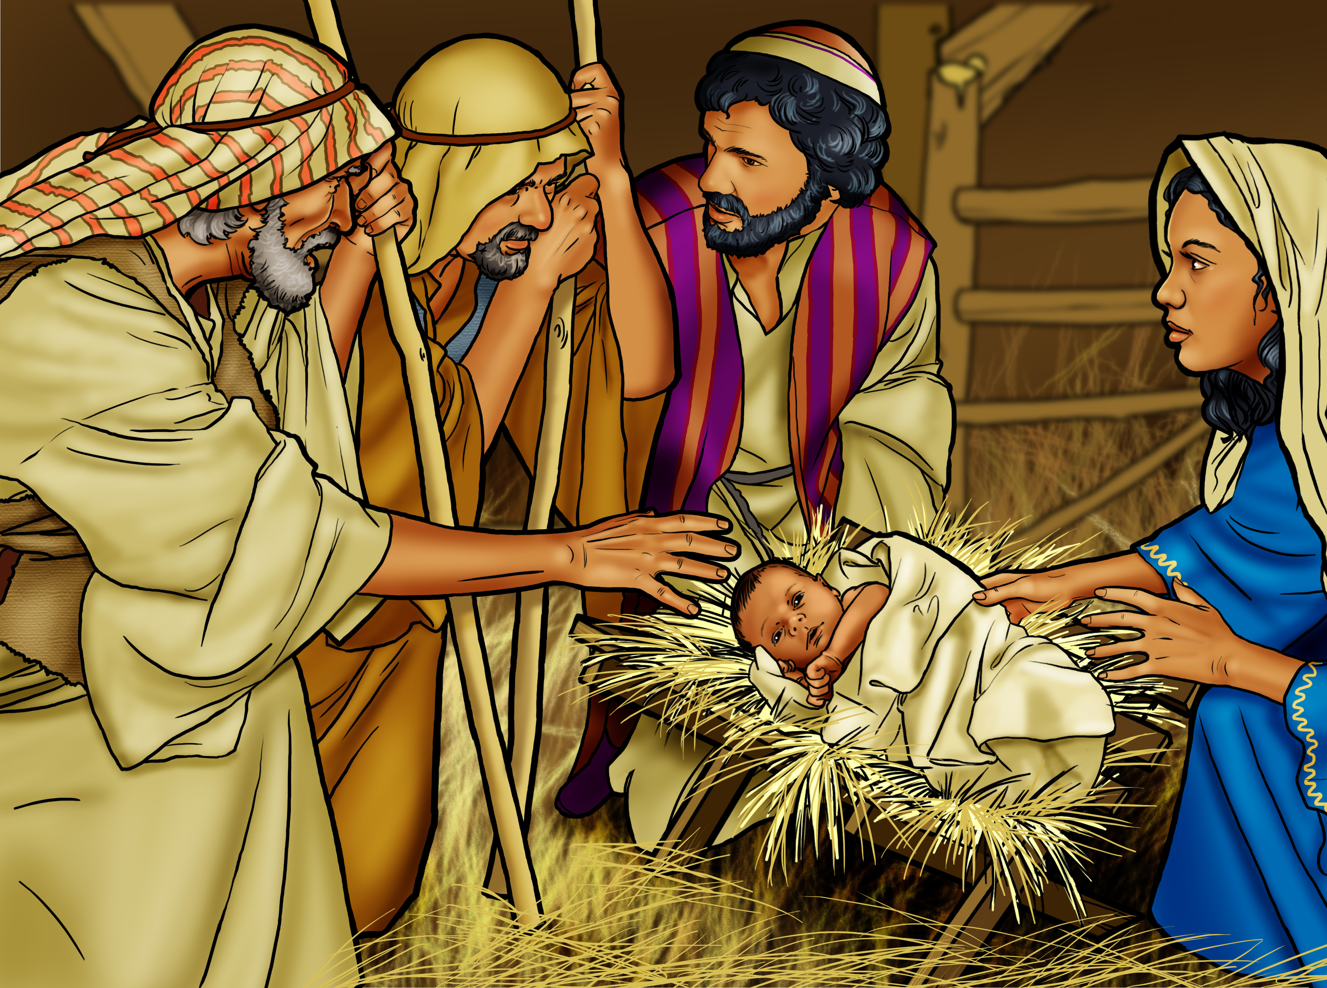
© Child Evangelism Fellowship of Europe, Child Evangelism Fellowship Inc.

Slide 9
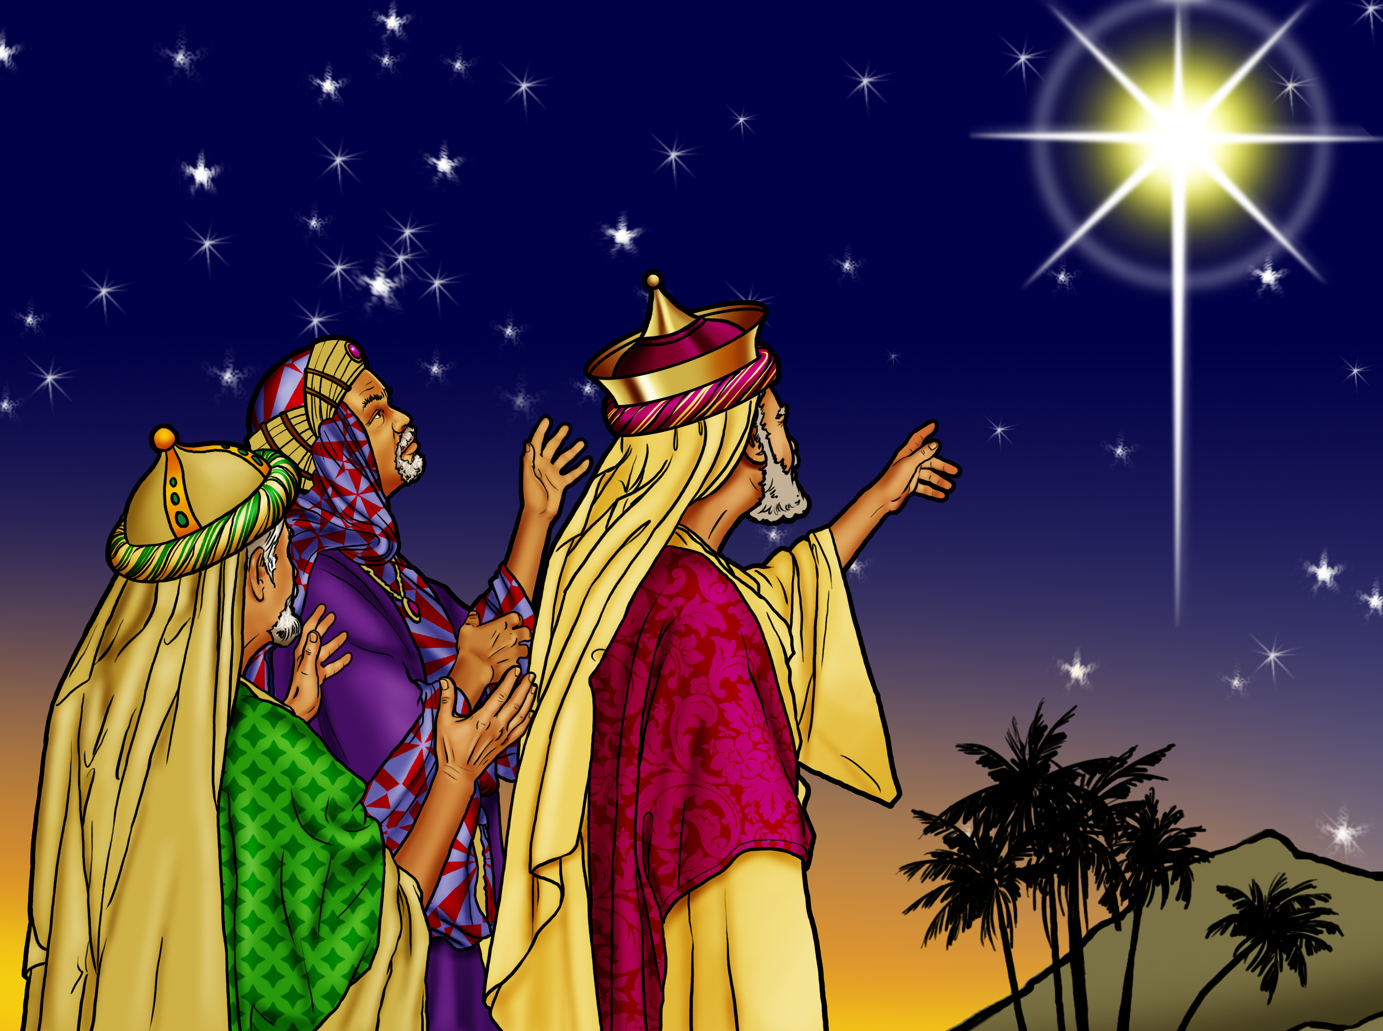
© Child Evangelism Fellowship of Europe, Child Evangelism Fellowship Inc.

Slide 10
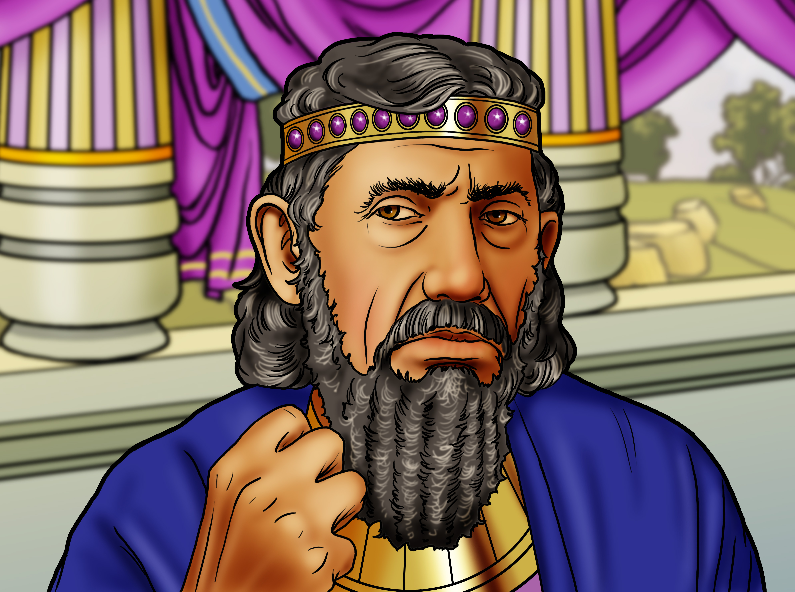
© Child Evangelism Fellowship of Europe, Child Evangelism Fellowship Inc.

Slide 11
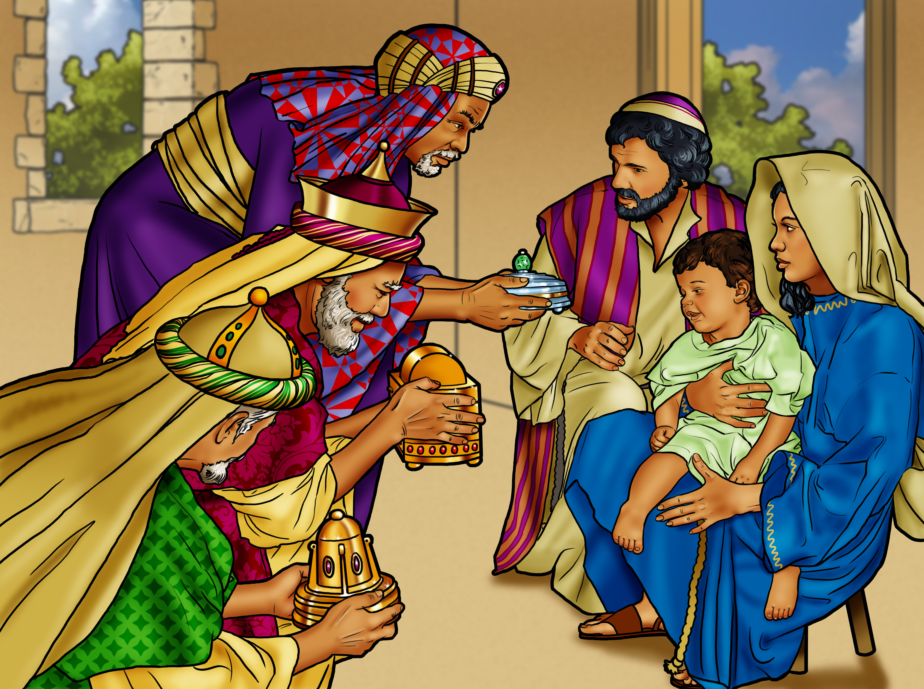
© Child Evangelism Fellowship of Europe, Child Evangelism Fellowship Inc.

Slide 12
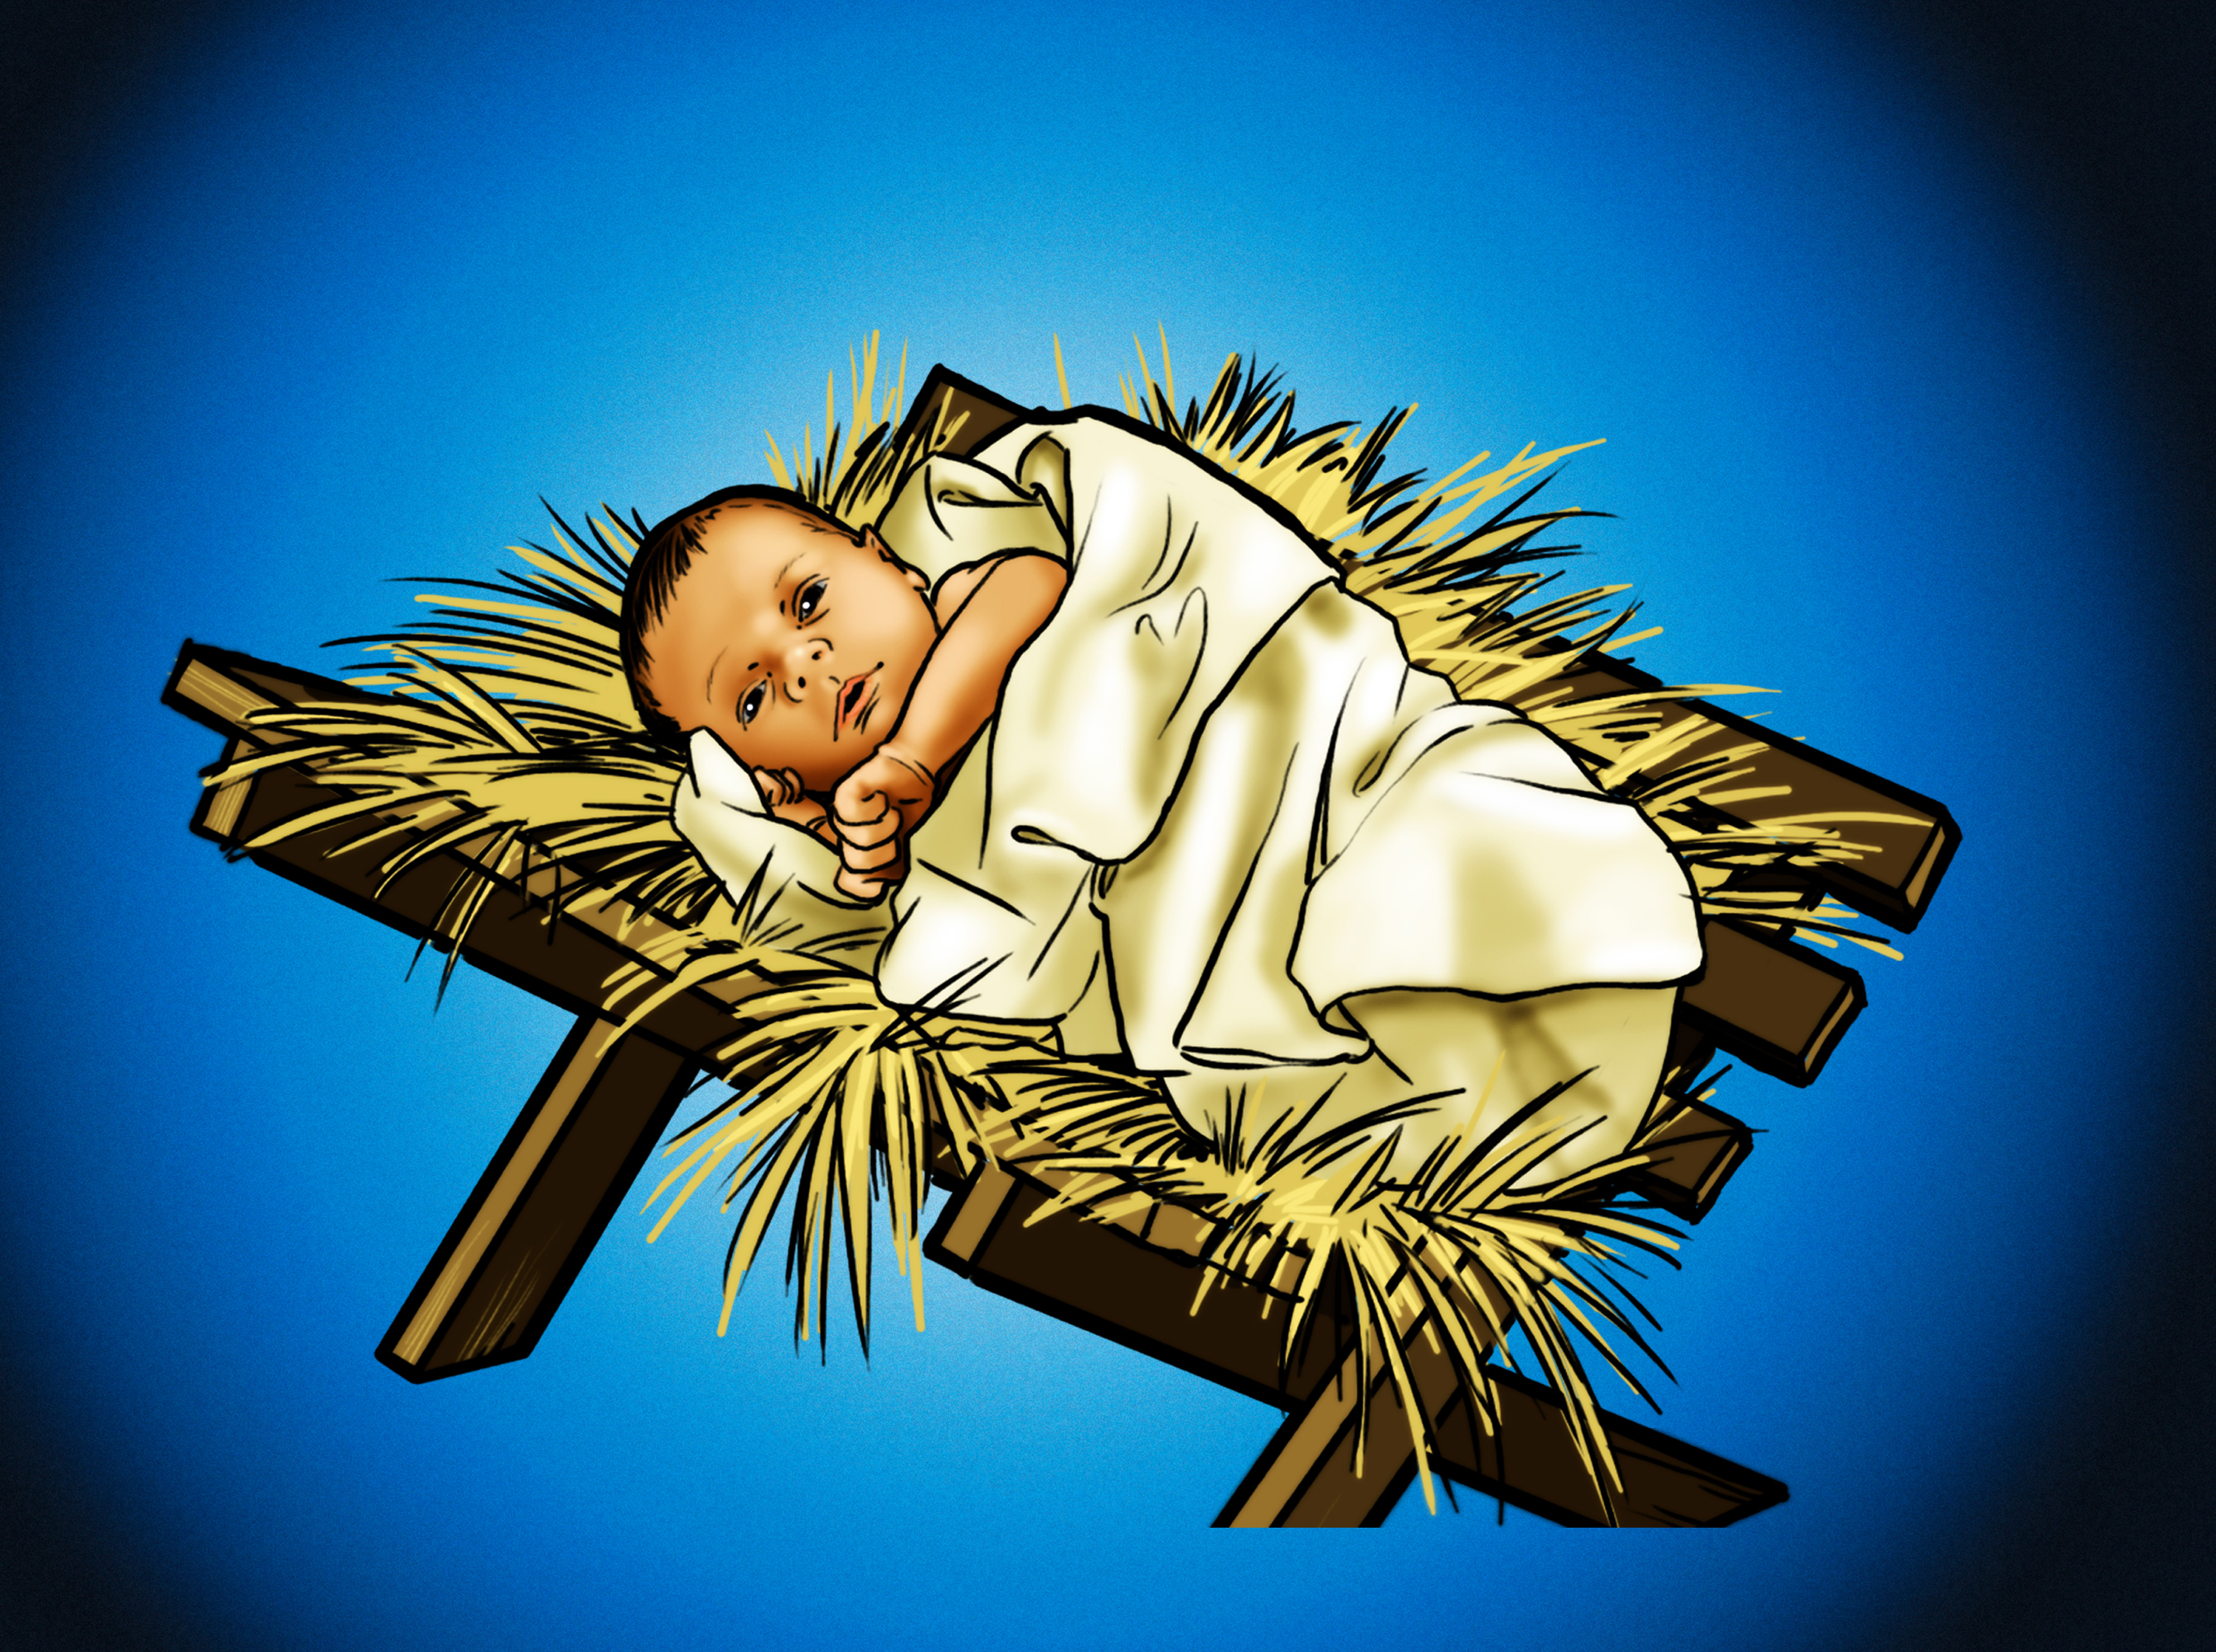
© Child Evangelism Fellowship of Europe, Child Evangelism Fellowship Inc.

Slide 13
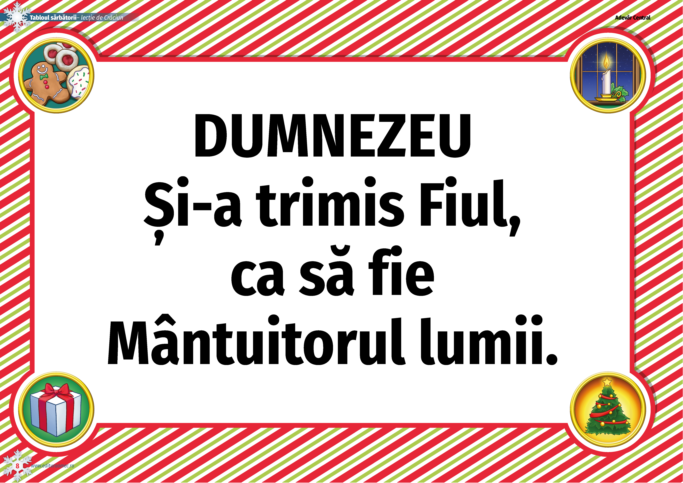
© Child Evangelism Fellowship of Europe

Slide 15
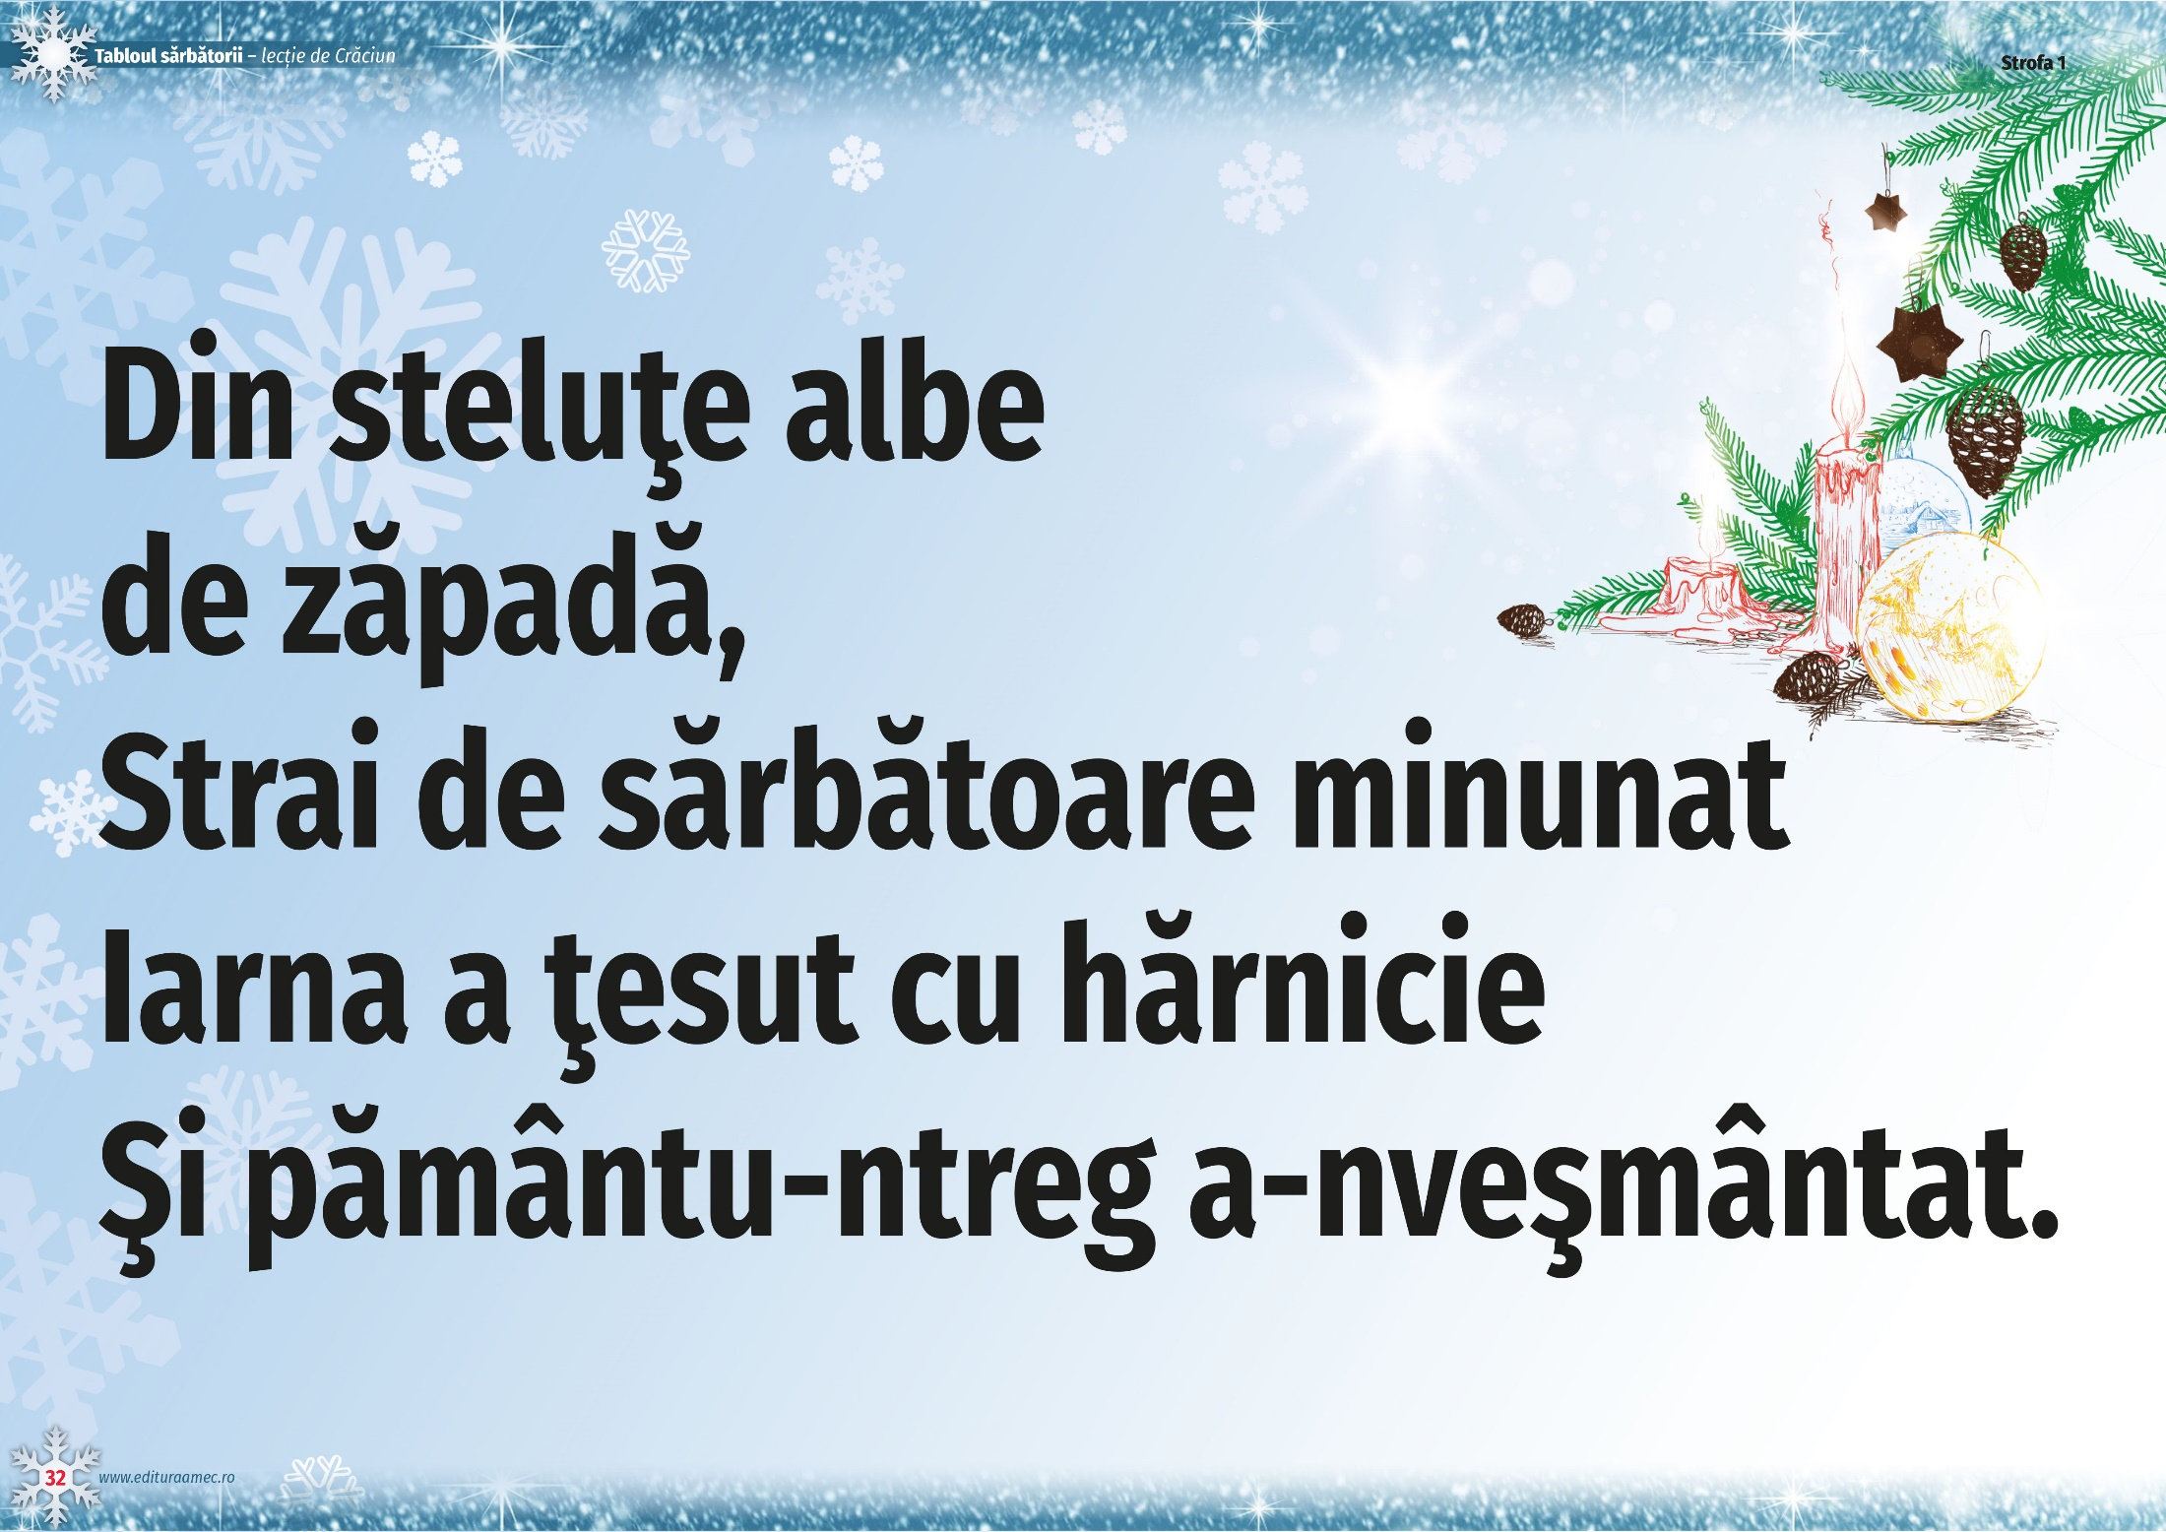

Slide 16


Slide 17
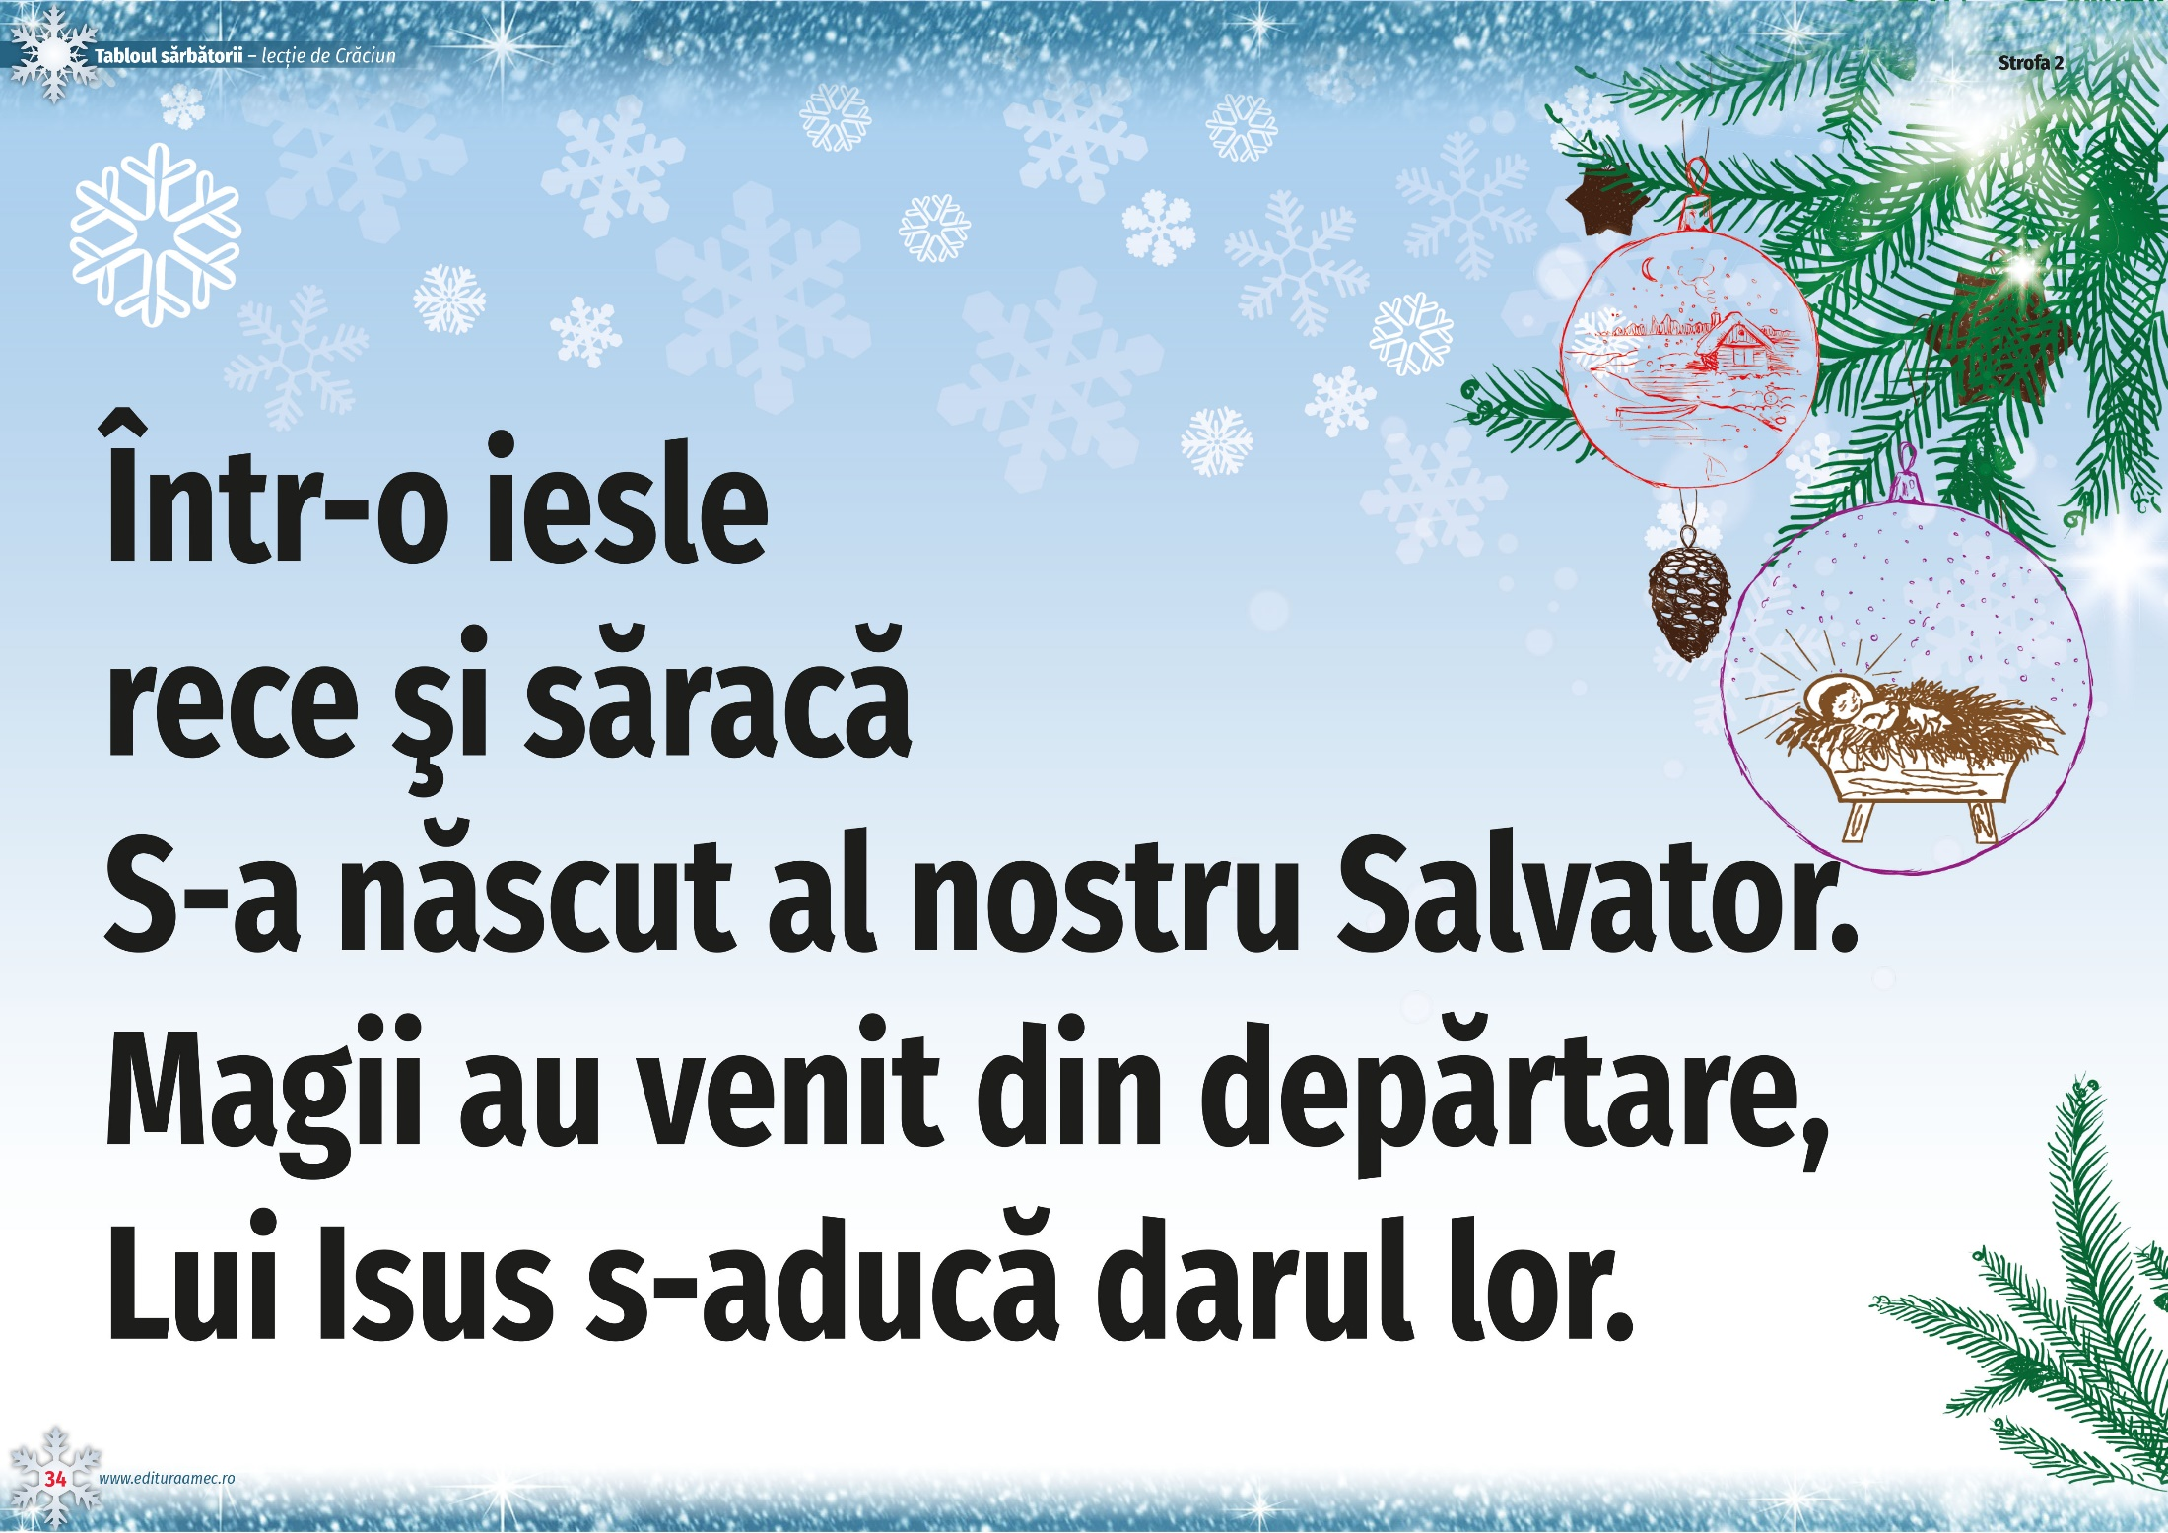

Slide 18
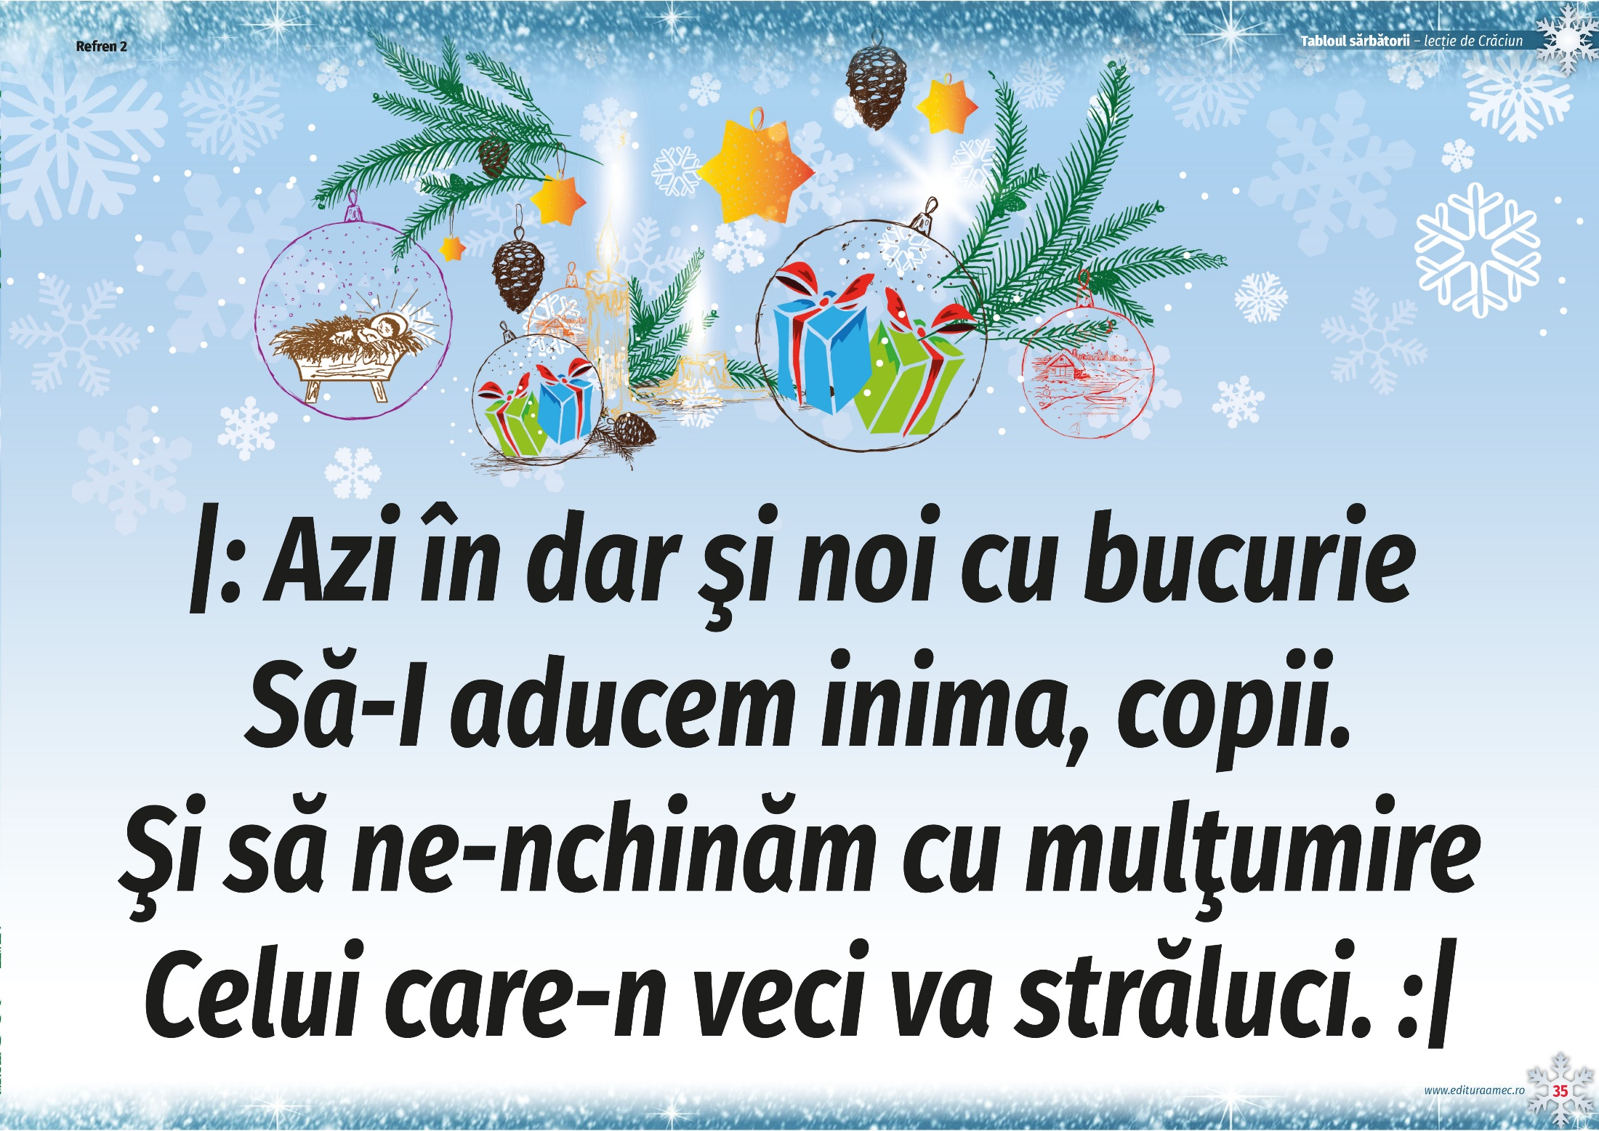

Slide 20


